Slide 1
Use Case Diagram: “On a Player’s Turn”
Move pawn to adjacent tile
Combine flood discard and flood deck and shuffle
Take up to 3 Actions
Player 1
Shore up adjacent tile
Increment water level by 1
<< include >>
Player 1
<< extend >>
Player 2
Give Treasure Card to Player on same tile
Player 2
Draw 2 Treasure Cards
Capture Treasure
(Optional) Player 3 and/or Player 4
(Optional) Player 3 and/or Player 4
Check Water Level
Discard 4 matching treasure cards
Draw Flood Cards
<< include >>
Flip unflooded tiles to flooded or remove flooded tiles
<< system >> Forbidden Island

Slide 2
Sequence Diagram: “Setting up the Game for Game Loop”
Players
Island Tiles
Board
Flood Deck
Flood Discard
Pawn
Treasure Deck
Water Level
Treasure
addFloodDiscard()
createBoard()
assignPawnPosition()
floodTiles()
setWaterLevel()
drawTreasureCards()
Loop
Opt
movePawn()
giveTreasureCard()
shoreUp()
captureTreasure()
drawTreasureCards()
getWaterLevel()
WaterLevel
floodCards
drawFloodCards()

Slide 3
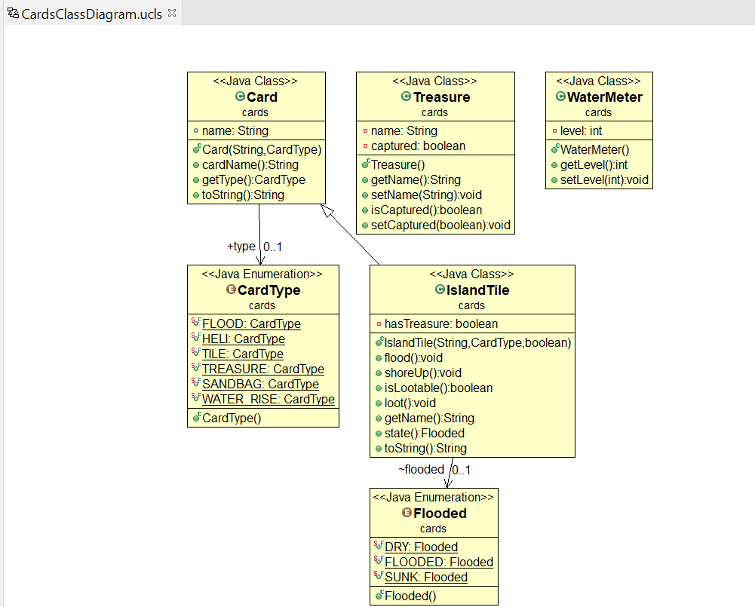

Slide 4
